Slide 1
ASP.NET v5 and .NET Core Intro
Mario Szpuszta
Principal Program Manager
DX TED, Global Emerging & Opportunistic SaaS
Microsoft Corp. HQ

Slide 2
Agenda – Prep for a Fun-Hackfest...
.NET Core and ASP.NET v5 Context
What, why, where, how?
Getting used to KVM, KPM & Co
Become familiar with the most important commands, understand some internals
Setting up Linux & Windows Dev-Environments
Setup KVM, KPM & Co with Sublime and Atom as editors from scratch
ASP.NET MV6 and WebAPI Quick walk-through
How does a typical app look like, what are the resources to look for new details

Slide 3
ASP.NET v5 and .NET5
Light into the shadows...

Slide 4
ASP.NET v5 & .NET Core – Why?
Modularization
Separation of the monolything, huge framework
Better side-by-side hosting of the runtime
New dependency management entirely based on packages
Integration with 3rd-party tools eco-system
Relax dependency on Visual Studio (again☺)
Leverage the (open source) tool chain and eco-system of the web (grunt, bower etc.)
Cross-Platform, Cloud-Optimized
Develop and host on Linux, Mac and Windows
Embrace runtime execution and configuration that works everywhere

Slide 5
ASP.NET v5 & .NET Core – Where?
Notes:
Add a

Slide 6
KVM, KPM, K & Co
How does it work behind the scenes...

Slide 7
.NET Cloud Optimized
.NET Core (a.k.a. CoreCLR)
Slimmed down version of .NET
Not included: especially WinForms, WPF, WebForms, WCF, WIF, WF
NuGet package management at its core
Libraries, modules and frameworks managed via NuGet
Runtime versions byitself managed via NuGet
True side-by-side versioning
No „in-depth system installation“, anymore
Notes:
Add a

Slide 8
KVM, KPM, K ...
K hosting process for .NET applications
similar to java.exe or node.cmd
KPM K package manager
similar to NPM in NodeJS
works with NuGet behind the scenes
KVM K Version Manager
starting point of each installation
manage and install versions of the K-runtime (aka K and KPM)
Notes:
Add a

Slide 9
Installation of .NET Core 5
Everything „installed“ in user profile
No admin permissions required
Start with downloading KVM
Shell scripts (Powershell, bash etc.) or on Windows with MSI
Define „alias“ and „use“ specific runtime versions
Alias is a short-cut to a specific runtime
No magic, all very „basic“ concepts
Environment variables, shell scripts, powershell scripts and text files
Notes:
Add a

Slide 10
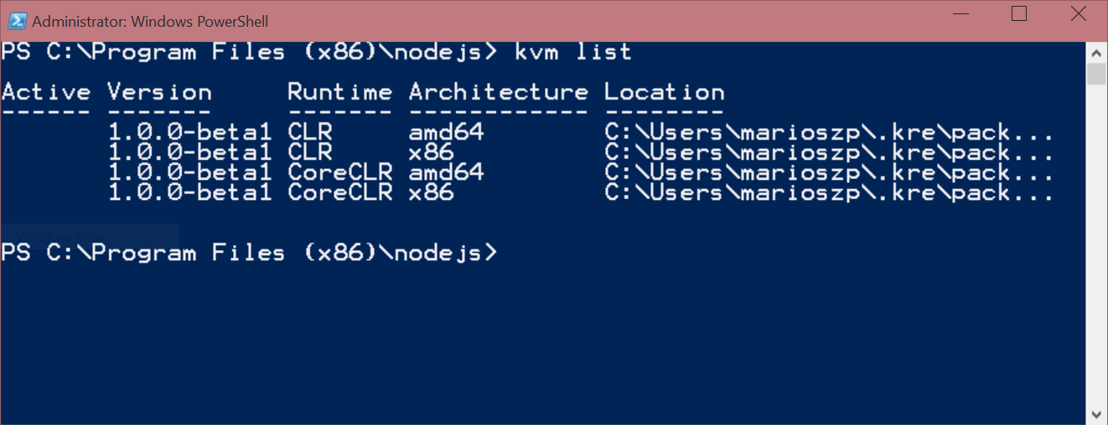
Installation of .NET Core 5 (Windows)
Follow instructions on http://github.com/aspnet
Exact scripts for each OS installation available
Or just install Visual Studio 2015 Ultimate Preview
@powershell -NoProfile -ExecutionPolicy unrestricted -Command "iex ((new-object net.webclient).DownloadString('https://raw.githubusercontent.com/aspnet/Home/master/kvminstall.ps1'))"
kvm upgrade
kvm list
Notes:
Add a

Slide 11
Installation of .NET Core 5 (Linux)
Follow instructions on http://github.com/aspnet
Install Mono 3.4.1 or newer (http://www.mono-project.com/docs/getting-started/install/linux/)
Download the kvm.sh shell script and follow instructions on aspnet github home
sudo apt-key adv --keyserver keyserver.ubuntu.com --recv-keys 3FA7E0328081BFF6A14DA29AA6A19B38D3D831EF
echo "deb http://download.mono-project.com/repo/debian wheezy main" | sudo tee /etc/apt/sources.list.d/mono-xamarin.list
apt-get install mono-complete
curl -sSL https://raw.githubusercontent.com/aspnet/Home/master/kvminstall.sh | sh && source ~/.kre/kvm/kvm.sh
source /home/USERNAME/.kre/kvm/kvm.sh
kvm upgrade
kvm list
Notes:
Add a

Slide 12
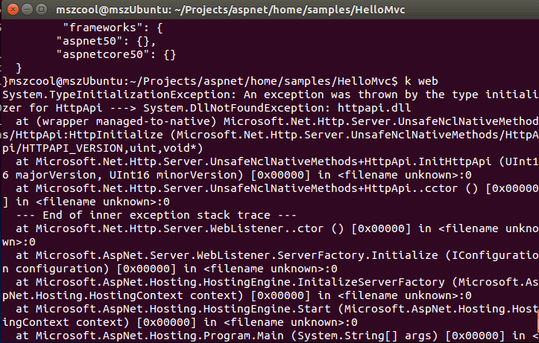
Krestrel and Linux
Kestrel -> cross-platform web server
Native written in .NET Core 5
Works on Windows, Mac and Linux
Known bug in Beta1/2 on Linux
https://github.com/aspnet/KestrelHttpServer/issues/29
wget http://dist.libuv.org/dist/v1.0.0-rc2/libuv-v1.0.0-rc2.tar.gz
tar -xvf libuv-v1.0.0-rc2.tar.gz
cd libuv-v1.0.0-rc2/ ./gyp_uv.py -f make -Duv_library=shared_library
make -C out
sudo cp out/Debug/lib.target/libuv.so /usr/lib/libuv.so.1.0.0-rc2
sudo ln -s libuv.so.1.0.0-rc2 /usr/lib/libuv.so.1

Slide 13
Development Environment
Developing across operating systems

Slide 14
Setup Sublime with OmniSharp
Install Sublime Text 3 from www.sublimetext.com
Packages for Windows (MSI) and Linux (tar.gz or native for distribution)
Install Sublime Package Control
Package manager for add-ons of Sublime Text
Install Kulture Plug-In (ASP.NET5 build plug-in)
Enables building an ASP.NET Core 5 project from within Sublime
Install & configure OmniSharp from Package Control
External server used by sublime for IntelliSense and live code validations
http://www.omnisharp.net/ and http://omnisharp-sublime.readthedocs.org/en/latest/
Notes:
Add a

Slide 15
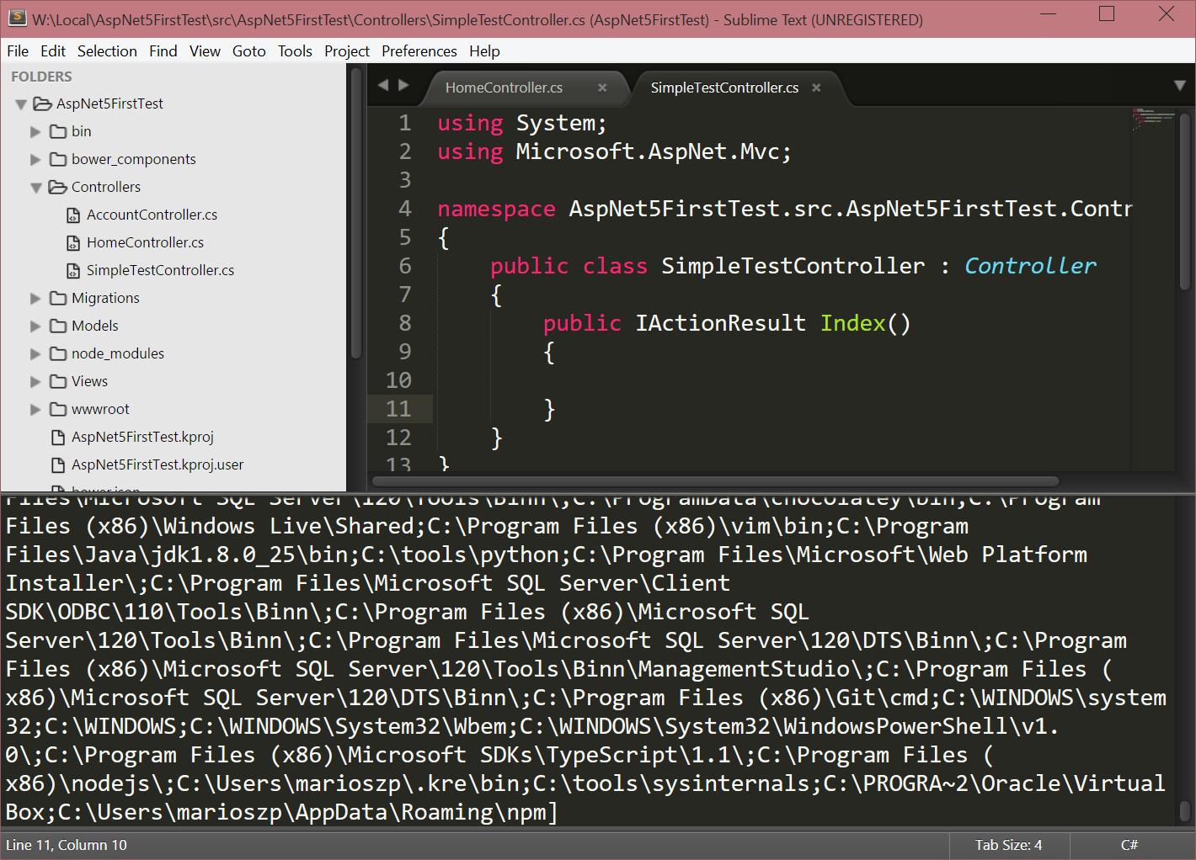
Configure OmniSharp
Create a Sublime Project
Open a folder containing a project.json or *.sln file
Add a *.sublime-project file if a solution to be used
For project.json no further steps required
Start Sublime from a command prompt
Execute „k use“ before starting sublime
Thus Kulture will recognize kpm & co
{
"folders":
[
{
"follow_symlinks": true,
"path": "."
}
],
"solution_file": "./AspNet5FirstTest.sln"
}
Notes:
Add a

Slide 16
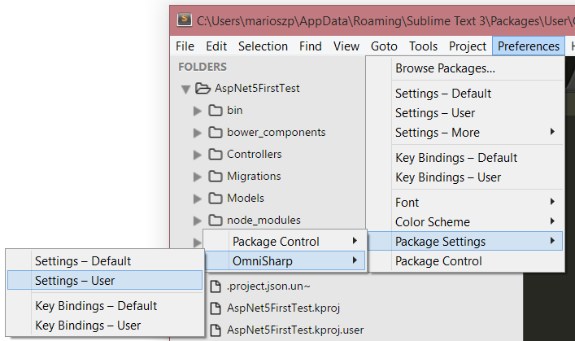
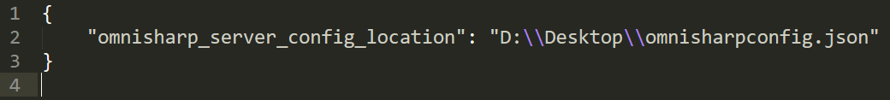
Configure OmniSharpServer
OnmiSharp server
Responsible „back-end“ for IntelliSense & Co
Installed as part of OmniSharp plug-in installation
Configuration
Config.json in „Browse Packages“
Configure user settings via „Perferences – Package Settings“
Notes:
Add a

Slide 17
ASP.NET 5 in Docker on Linux
ASP.NET Core 5 goes Container tech

Slide 18
Docker in General
Container technology (like super-lightweitght VMs)
High density on physical and virtual machines with isolation
Container images available on docker.io
Docker CLI for Windows
Still „work-in-progress“; manual clone-build-use installation
https://ahmetalpbalkan.com/blog/compiling-docker-cli-on-windows/
ASP.NET5 and Docker (on Linux;))
Microsoft provides a preview-image boostrapped with KVM, Kestrel & Co.
http://blogs.msdn.com/b/webdev/archive/2015/01/14/running-asp-net-5-applications-in-linux-containers-with-docker.aspx
Notes:
Add a

Slide 19
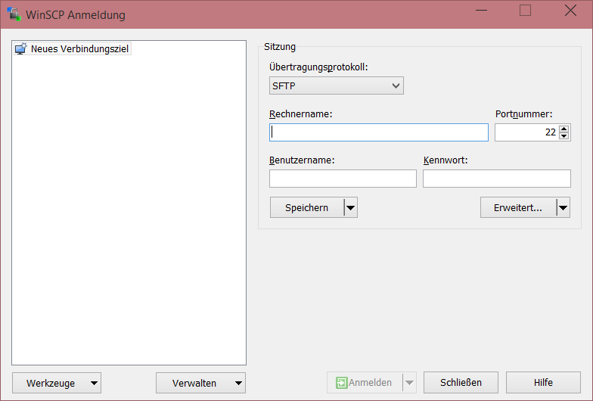
Handy Tools for Windows + Docker Users
OpenSSL Toolkit (choco install openssl.light)
Generate SSL certificates for SSH and docker TLS to remote Linux docker hosts
https://chocolatey.org/packages/OpenSSL.Light
Boot2Docker
Allows running Docker on Windows (super lightweight VM)
https://chocolatey.org/packages/docker
GoLang programing language
Required to build the native docker CLI on Windows
http://chocolatey.org/packages/golang
WinSCP file transfer tool
Enables secure copy protocol based transfers to remote Linux hosts via SSH
https://chocolatey.org/packages/winscp
Notes:
Add a

Slide 20
ASP.NET MVC6 and WebAPI
Getting started for the hackfest

Slide 21
ASP.NET – Changes at the heart
New, modular HTTP request pipeline
Replaces traditional IHttpModule and IHttpHandler
Modular, fast/lean, flexible hosting, supports OWIN
Bootstrapping and Configuration
DI and IoC at core of the runtime
Environment-based configuration system
Tracing and diagnostics at low-level runtime
Low memory usage / high throughput
Still early, but expect much better memory effectiveness
Notes:
Add a

Slide 22
ASP.NET – Frameworks in 4.5
Web Pages, MVC , Web API
Share a lot but also a lot duplicated
Web Pages | MVC | Web API
Razor (syntax, parser)
HTML Helpers | HTML Helpers
 | Controllers | Controllers
 | Actions | Actions
 | Filters | Filters
 | Model binding | Model binding
 | DI | DI
Notes:
Add a

Slide 23
ASP.NET – Frameworks in 4.6 and .NET 5
MVC 6 = Web Pages + MVC + Web API
Shared code base and re-usable assets across all frameworks
Web Pages | MVC | Web API
Razor (syntax, parser)
HTML Helpers
Controllers
Actions
Filters
Model binding
DI
Notes:
Add a

Slide 24
ASP.NET – Frameworks in 4.6 and .NET 5
MVC 6 = Web Pages + MVC + Web API
Shared code base and re-usable assets across all frameworks
All built around DI
Foundation for bootstrapping every MVC6 app, default DI container, fully extensible
Enables transition from simpler -> sophisticated
Mix MVC, WebAPI and Web Pages as apropriate without „duplicate in-memory“
Dynamic build (in-memory)
Based on Roslyn; enabled edit -> F5 in browser cycle
Notes:
Add a

Slide 25
Thank You!!
http://blog.mszcool.com

